Slide 1
超越学科界限的认知基础 Transdisciplinary Cognitive Foundation
Knowledge Representation Week 6
Ben Koo
October 12, 2020

Slide 2
The Essence of Knowledge Representation
Transforming a problem to an easier format to identify solution,
then, transform it back to its original form.

Slide 3
A simple exercise
Can you connect the dots from
A to A’, B to B’, and C to C’ without crossing any lines?
A
C
B
C’
B’
A’

Slide 4

What is a Homotopy?
The two dashed paths shown above are homotopic relative to their endpoints. The animation represents one possible homotopy.
Image and Text Source: https://en.wikipedia.org/wiki/Homotopy

Slide 5
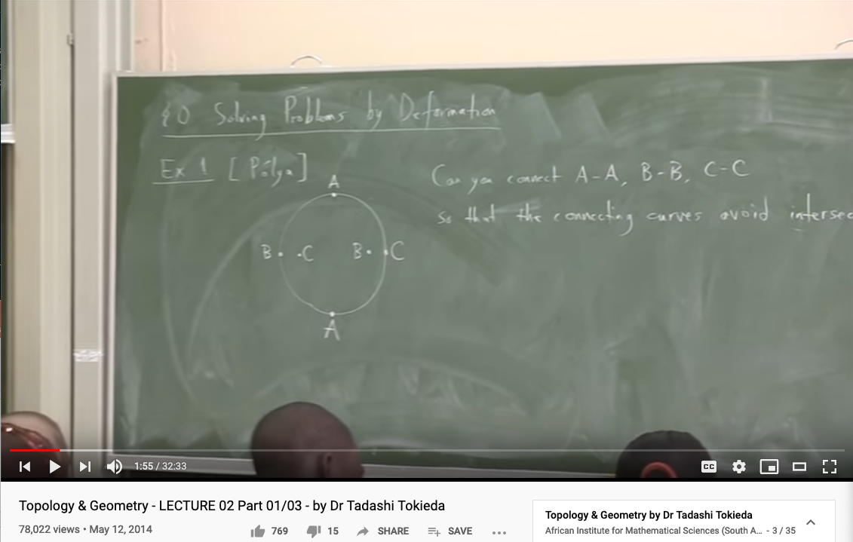
The Strategy of Topological Transformation
Youtube Link: https://youtu.be/8YDw4YxT-FM?t=398

Slide 6
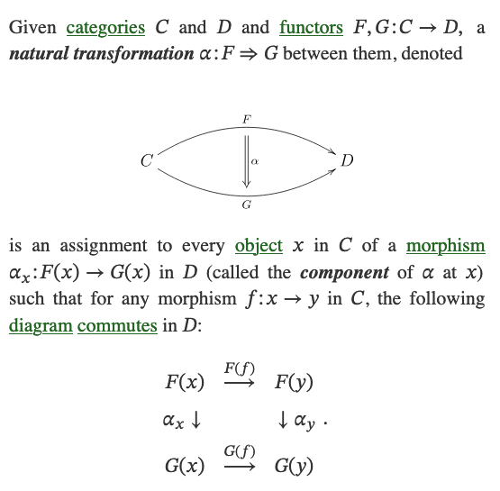
What is a Natural Transformation?
The two dashed paths shown above are homotopic relative to their endpoints. The animation represents one possible homotopy.
Image and Text Source: https://ncatlab.org/nlab/show/natural+transformation

Slide 7
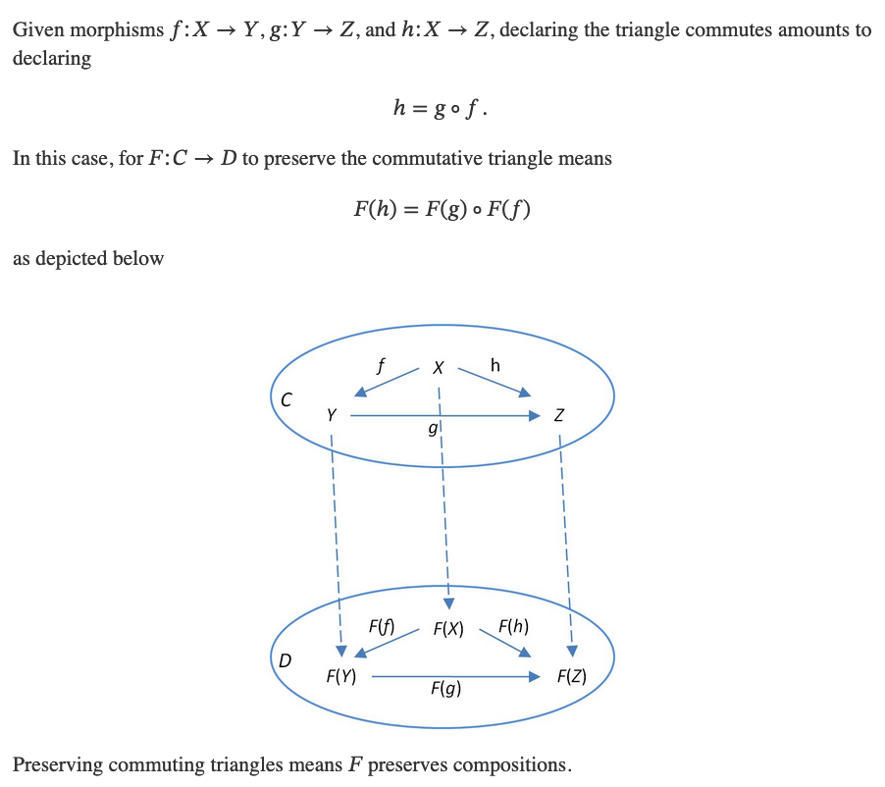
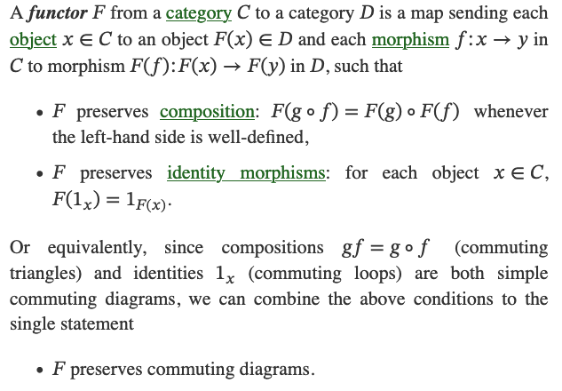
What is a Functor?
Image and Text Source: https://ncatlab.org/nlab/show/functor

Slide 8
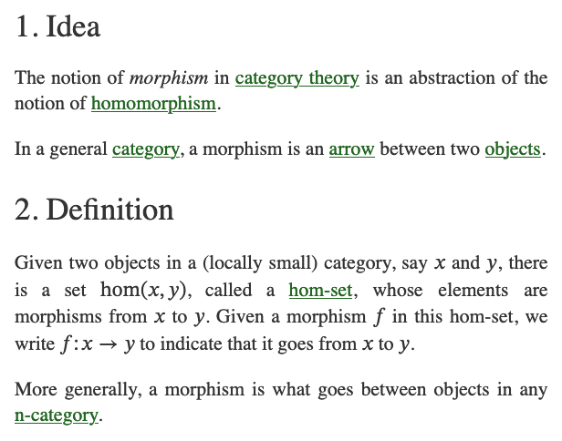
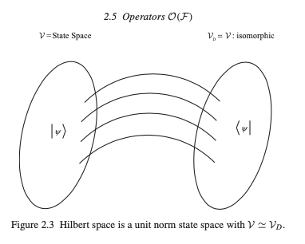
What is a Morphism (Function)?
Image and Text Source: https://ncatlab.org/nlab/show/morphism
Image Source: P.15 of Path Integral and Hamiltonian by Belal Baaquie

Slide 9
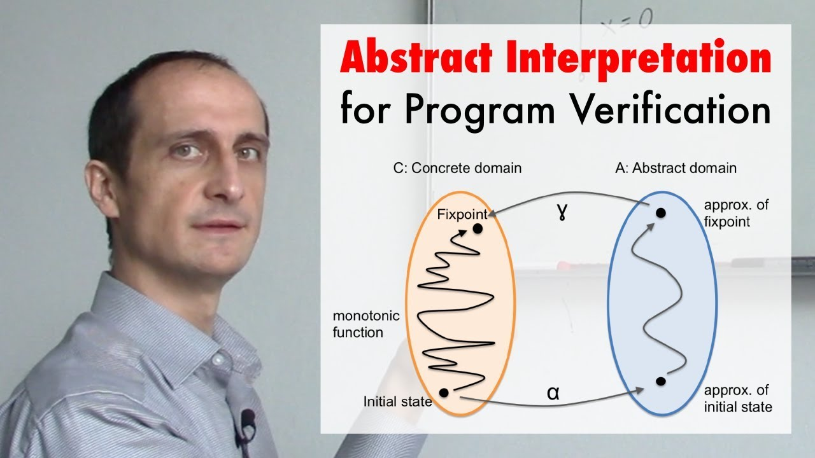
A short introduction video
https://youtu.be/j2m5YMnHvQQ

Slide 10
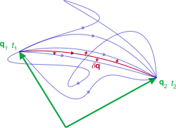
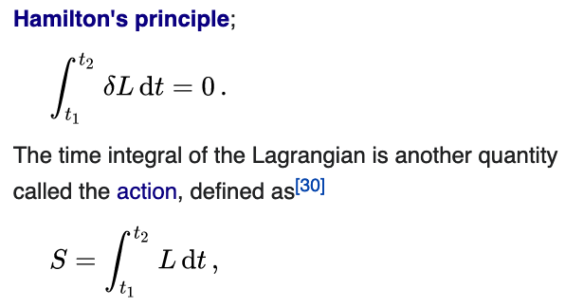
Representation of Action
Namespaces: labeled objects
Computations: transformative actions on the named objects
Action is a mathematical functional which takes the trajectory, also called path or history, of the system as its argument and has a real number as its result. Generally, the action takes different values for different paths.^{[1]} Action has dimensions of [energy]⋅[time] or [momentum]⋅[length], and its SI unit is joule-second. Action is only of interest when the total energy of the system is conserved.^{[2].}
- Wikipedia: Action
As the system evolves, q traces a path through configuration space (only some are shown). The path taken by the system (red) has a stationary action (δS = 0) under small changes in the configuration of the system (δq).^{[1]}
Source of Image and Text: Wikipedia on Hamilton’s Principle
Source of Image and Text: Wikipedia on Lagrangian Mechanics

Slide 11
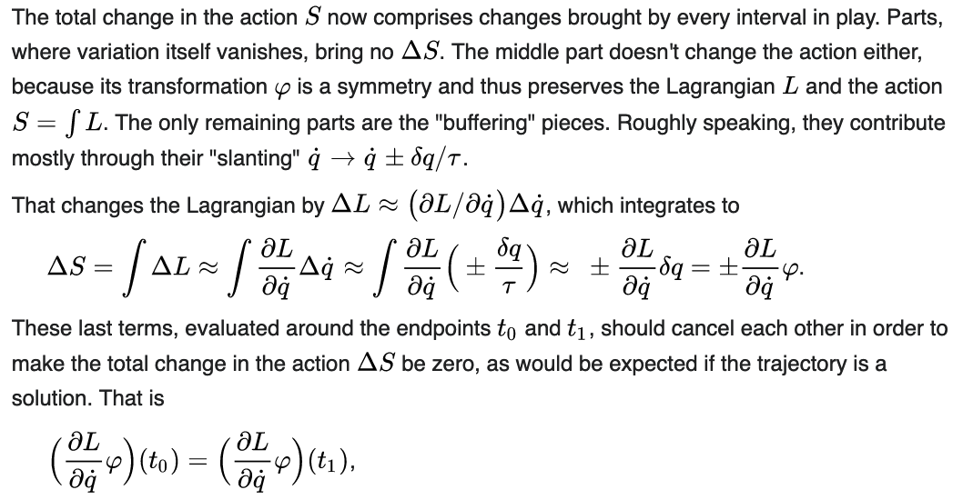
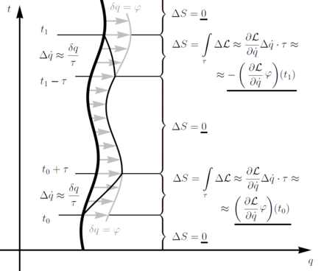
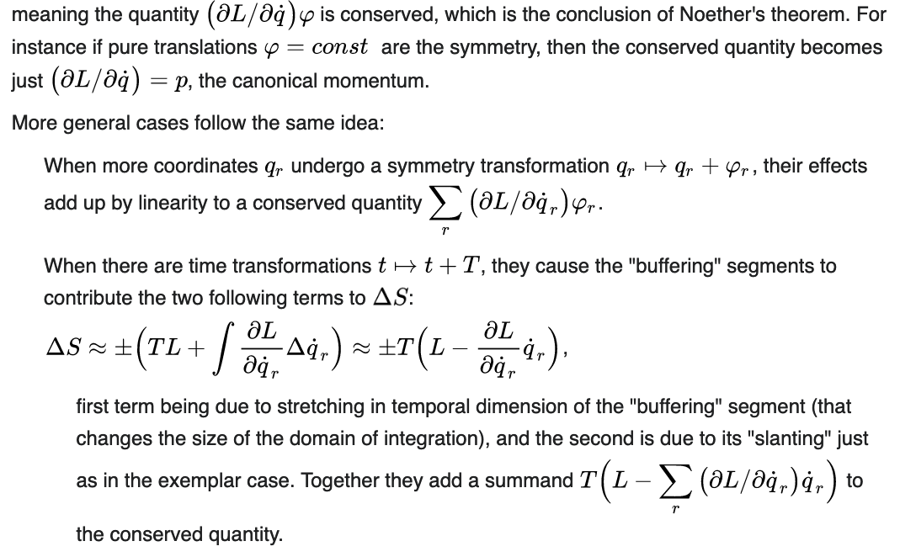
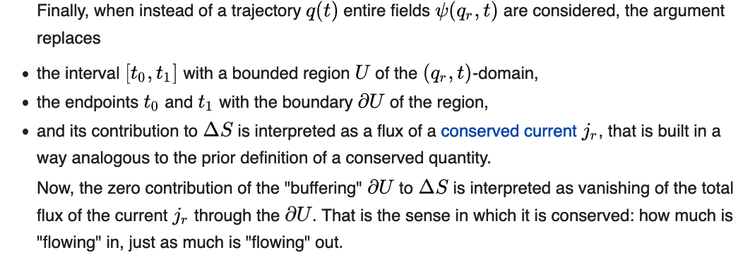
Change in Action S across multiple intervals
Source of Image and Text: Wikipedia on Noether’s Theorem

Slide 12
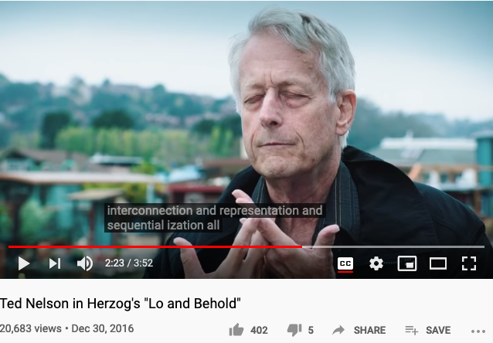
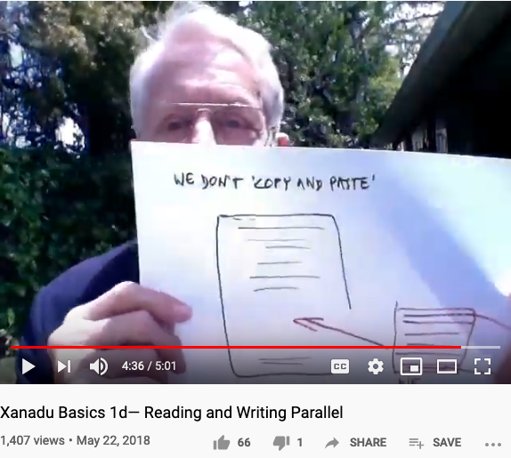
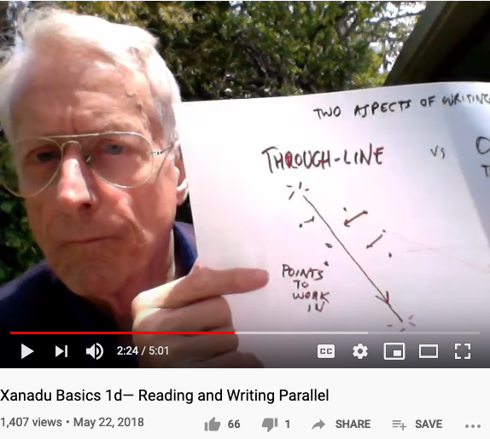
Let’s listen to Ted Nelson’s confession again
It was an experience of water and interconnection.
I was with my grandparents in a row boat in Chicago,
so I must have been five years old.
I was trailing my hand in the water and I thought about how the water was moving around my fingers, opening on one side and closing on the other, and that changing system of relationships where everything was kindof similar, kind of the same and the are different that was so difficult to visualize and express and just generalizing that to the entire universe that the world is a system of ever-changing relationships and structures, struck me as a vast truth… expressing that interconnection has been the center of all my thinking and all my computer work has been about expressing and representing and showing interconnection among writings especially. And writing is the process of reducing a tapestry of interconnection into a narrow sequence… they change the meaning of cut-and-paste and pretended it was the same thing… because humanity has no decent writing tools. … I consider that to be a crime against humanity and … this is the problem of interconnection and representation and sequentialization all similar to the issue of water.
- Youtube link: Lo and Behold the movie, section on interviewing Ted Nelson
Ted Nelson : “We don’t copy and paste, we transclude.”

Slide 13
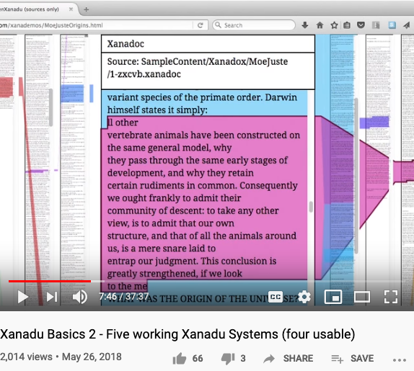
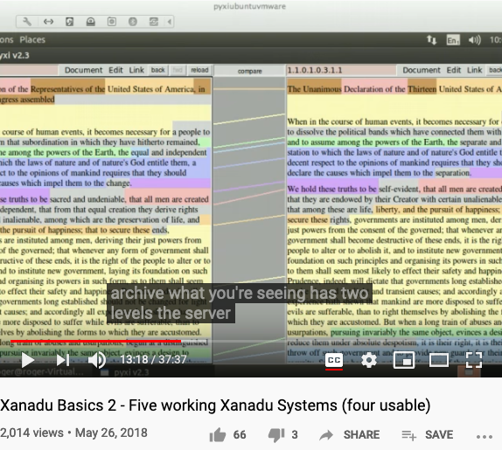

Some implementations of Ted Nelson’s Xanadu
Xanadu Classic is both an Operating System and a Document Management System.

Slide 14
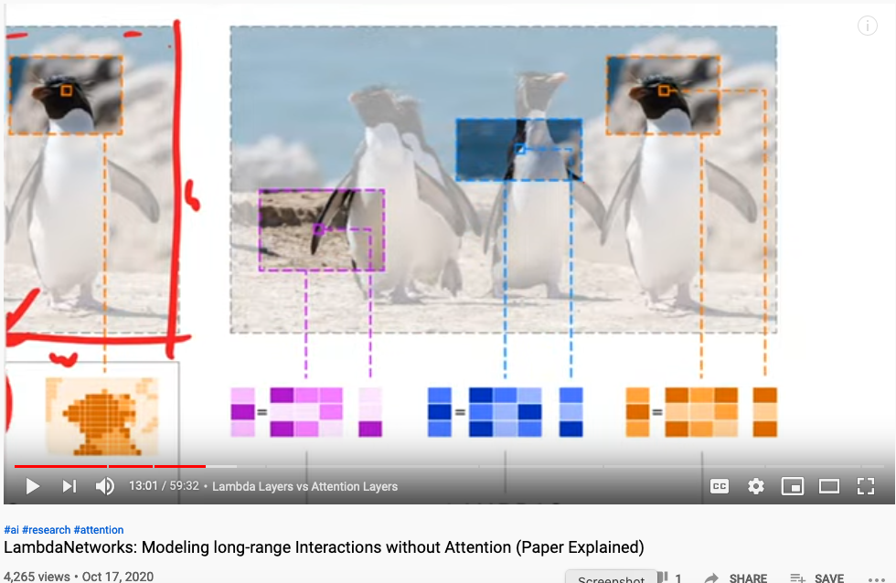
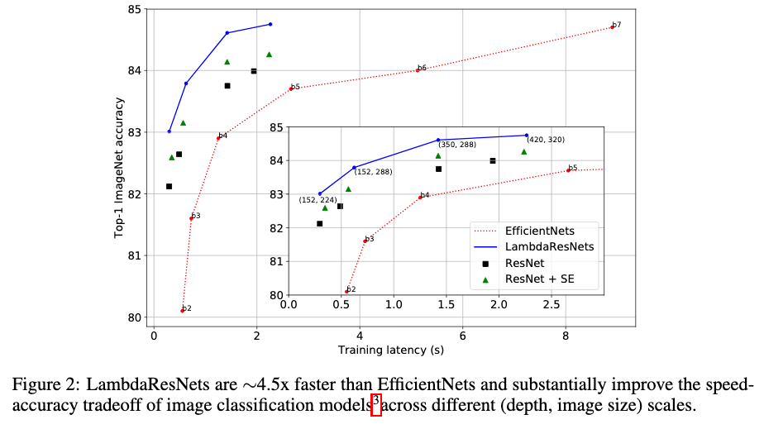
Representing Graphical Information Content
LAMBDANETWORKS: MODELINGLONG-RANGEIN-TERACTIONSWITHOUTATTENTION
Authors anonymous, under double blind review (ICLR 2021) last access: Oct 18, 2020

Slide 15
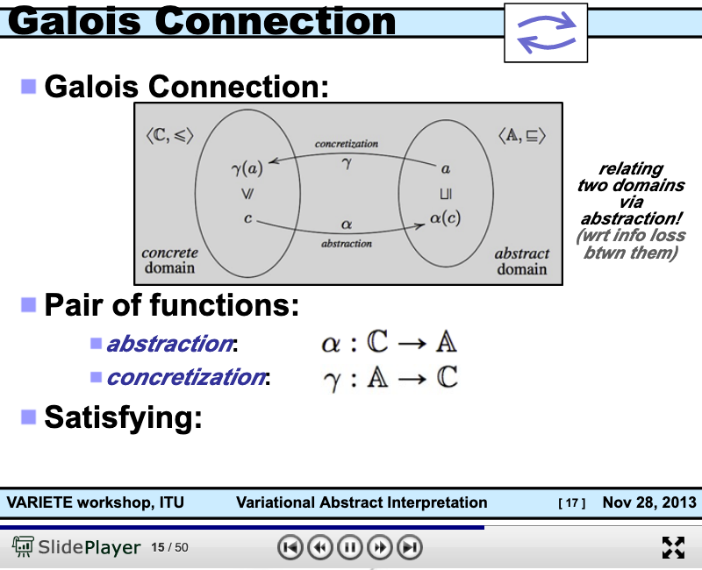
Connecting Abstract and Concrete Domains
https://slideplayer.com/slide/8506871/

Slide 16
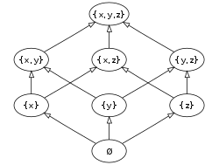
Abstract Interpretation is founded on Partially Ordered Set
The Hasse diagram of the set of all subsets of a three-element set {x, y, z}, ordered by inclusion. Distinct sets on the same horizontal level are incomparable with each other. Some other pairs, such as {x} and {y,z}, are also incomparable. (Image and Text Source: Wikipedia: POS )

Slide 17
Duality and Symmetries

Slide 18
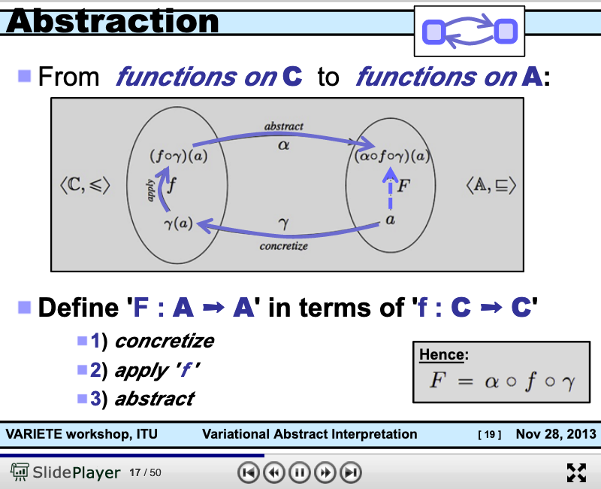
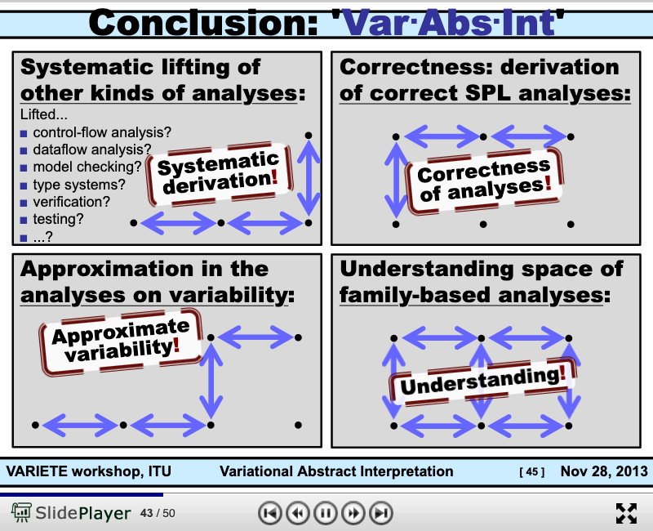
The Basic Working Principle of Composition
https://slideplayer.com/slide/8506871/

Slide 19
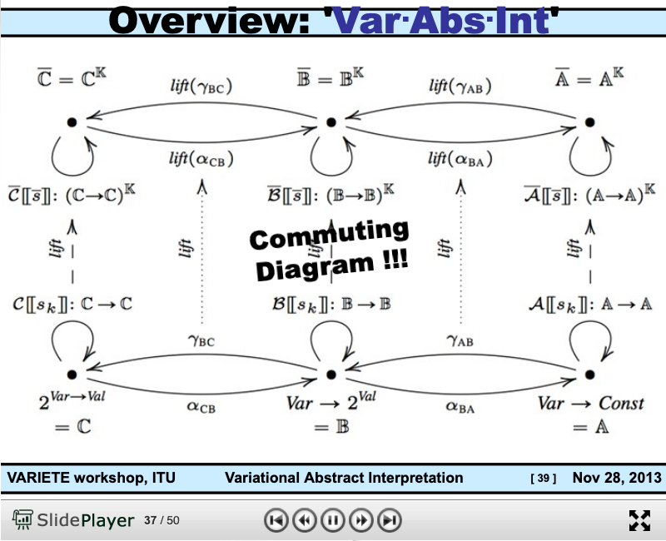
Arrow Chasing Computation
https://slideplayer.com/slide/8506871/

Slide 20
Abstraction
Concretization
Why is abstraction useful?
Allow reuse through universal properties
Avoid resource conflicts
Scale free and domain neutral
Generalizing concrete experience?
Make analogies in localized contexts
Engage sensible metaphors
Define terms and boundaries
A well-defined set of Actions and iterative Branching Strategies
A Roadmap of composable activities
Sequencing and timing conditions
Explicitly state dependencies and resource requirements

Slide 21
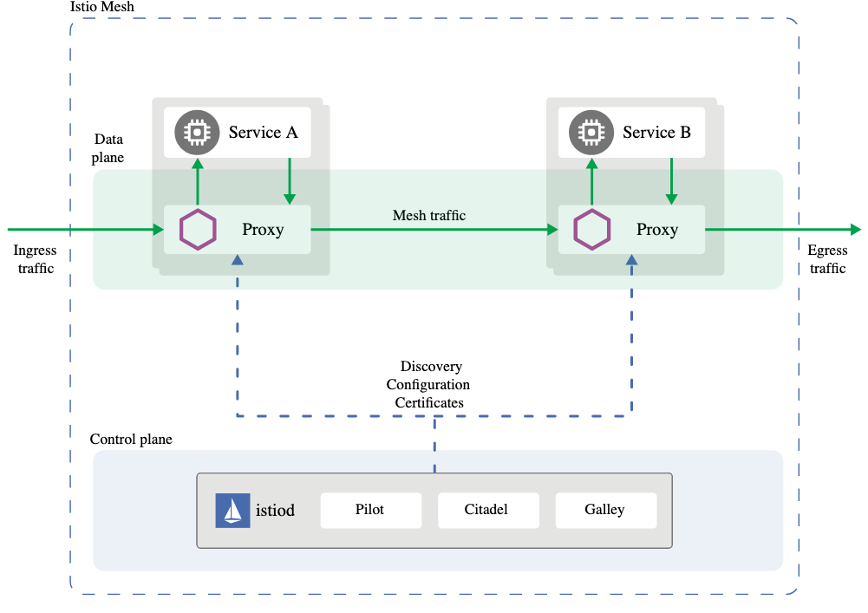
In the world of Internet of Things Checks and Balances
Data Plane
Abstraction
Concretization
Control Plane

Slide 22
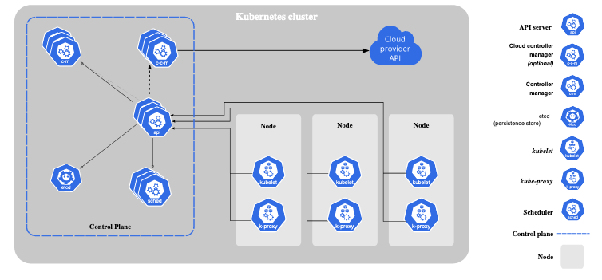
A New Kind of Operating Systems with built-in Governance
Data Plane

Slide 23
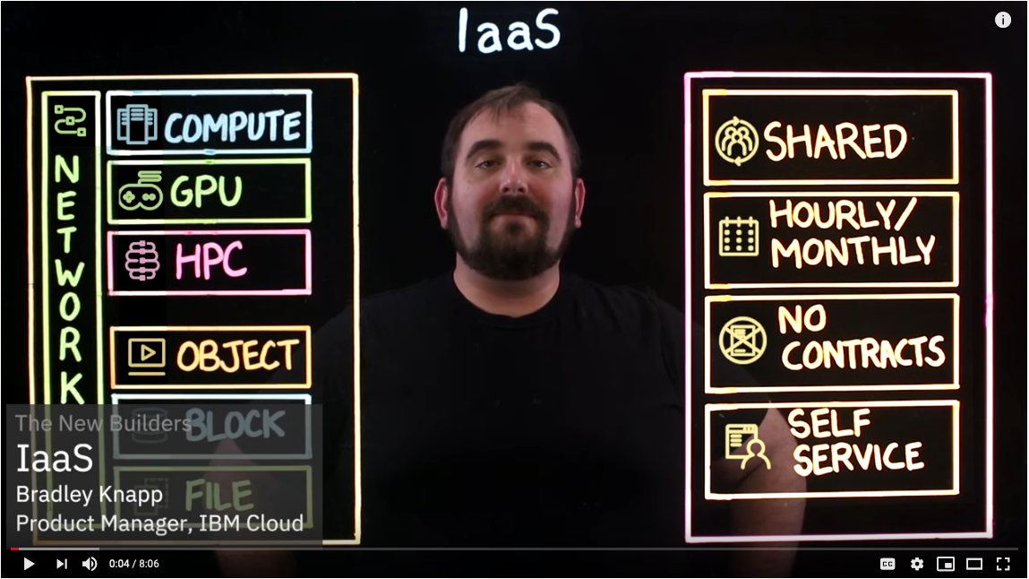
IaaS: Infrastructure as a Service

Slide 24
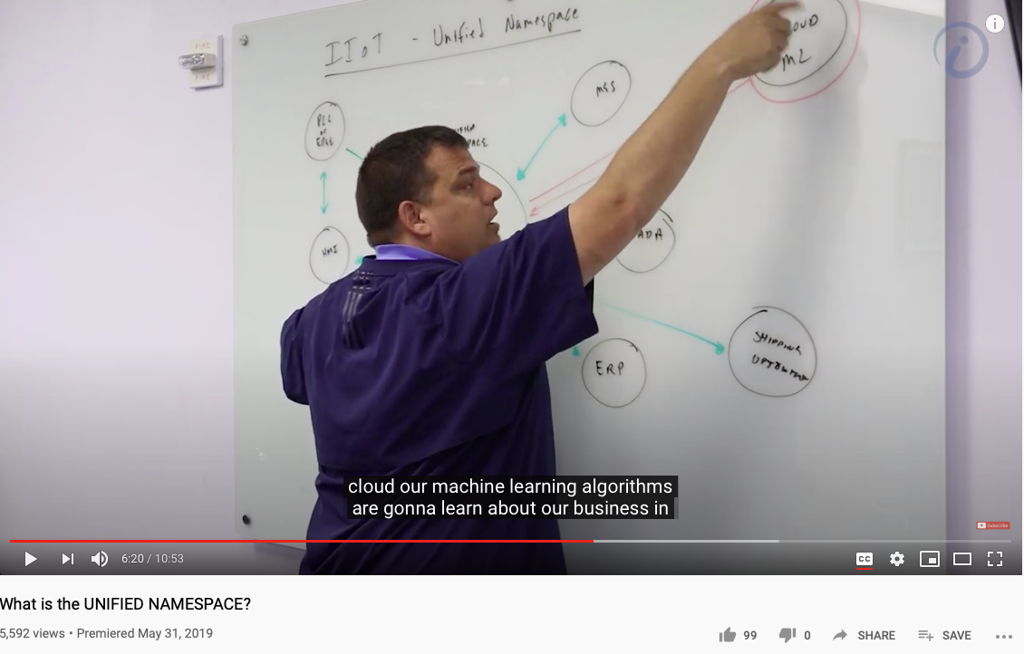
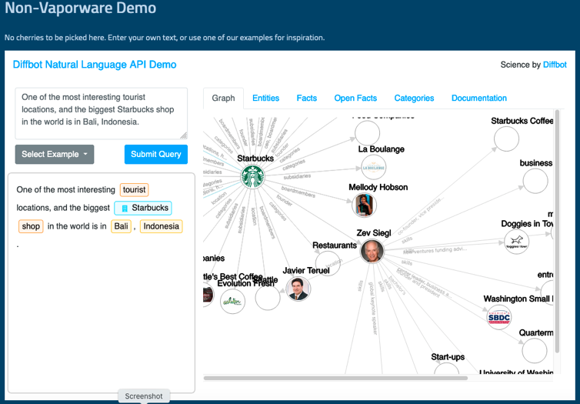
Unified Namespace

Slide 25
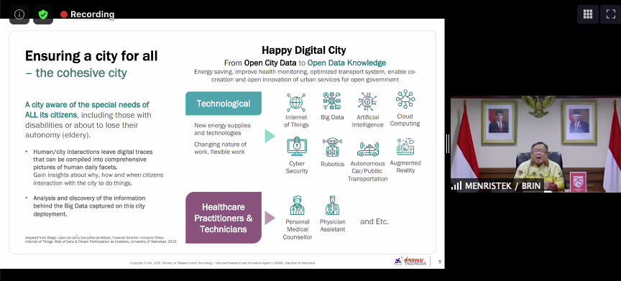
A Smart way to Govern Activities in Space-Time
Transform everything into Data
(Namespace Management)
Ongoing Development
RICH 70 Tsinghua SEA Cloud Forum, Sep 14, 2020
H. E. Bambang Brodjonegoro,
Minister of Research & Technology, Indonesia
Image credits: http://verses.io

Slide 26



Names of places mapped to names of concepts

Slide 27
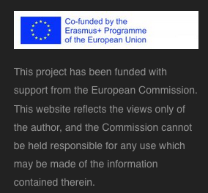
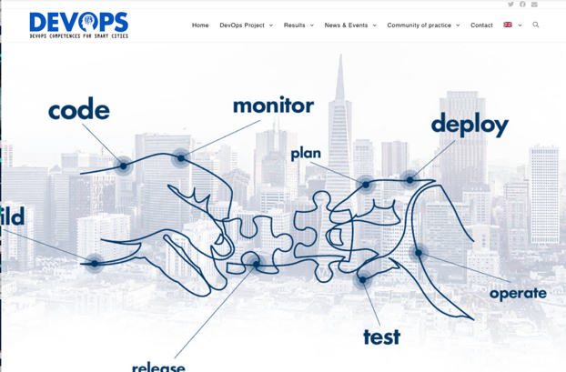


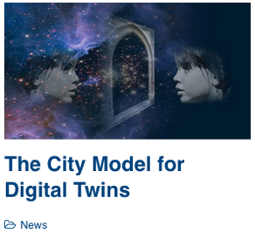

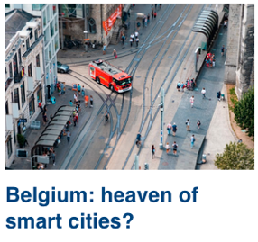
DevOps for Smart Cities

Slide 28

Universal Resource Locator, Identifier, Name as names of functions (especially with path information)
Video Link: https://youtu.be/vpYct2npKD8

Slide 29
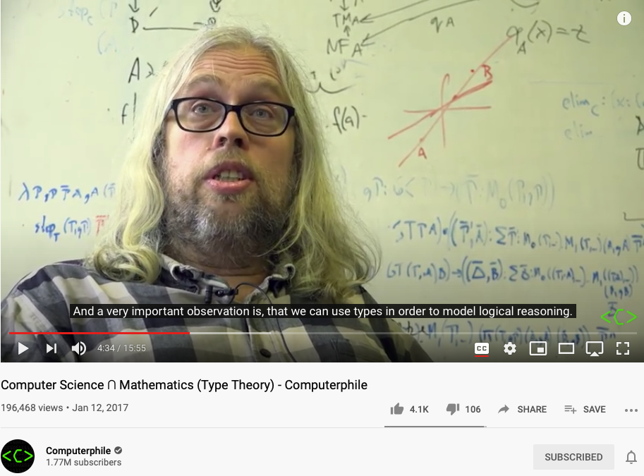
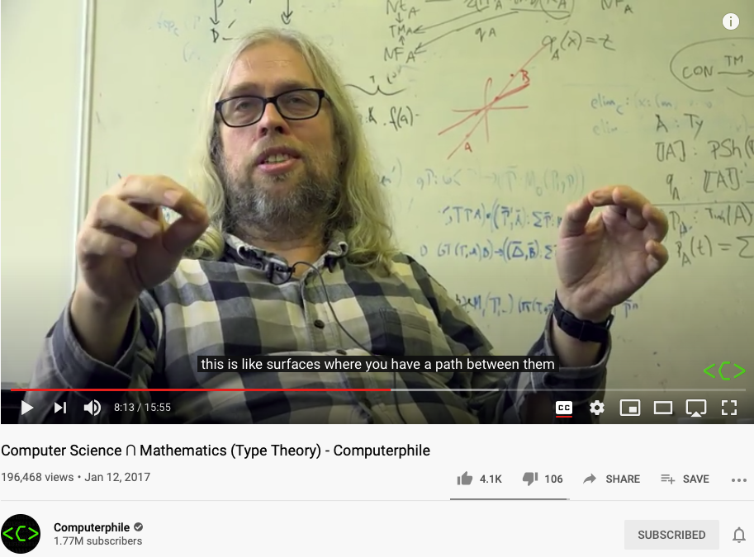
Modeling everything as Types of Functions
Because we cannot talk about implementation details, so that two things behaves the same on the outside must be the same.
This is the nature of
Namespace Management.
Video Link: https://youtu.be/qT8NyyRgLDQ?t=274
Video Link: https://youtu.be/qT8NyyRgLDQ?t=493

Slide 30
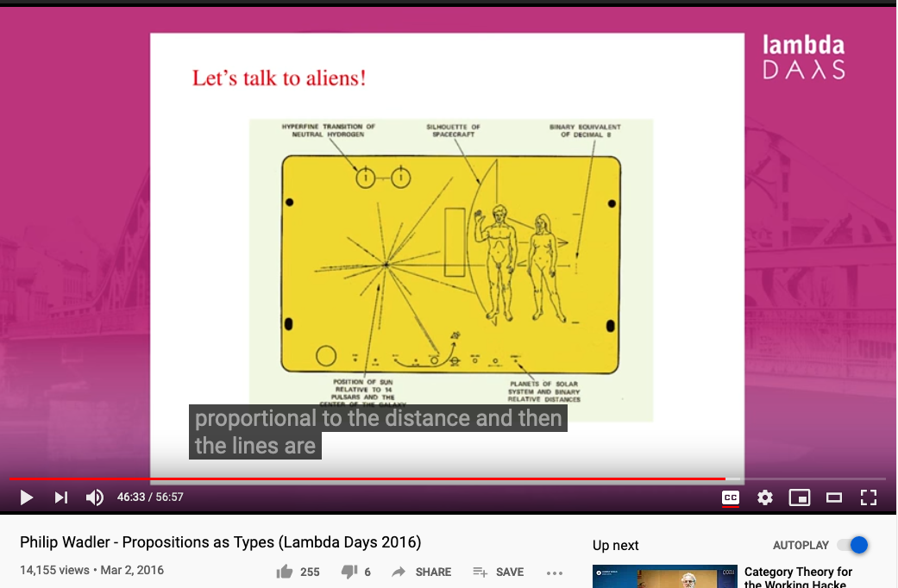
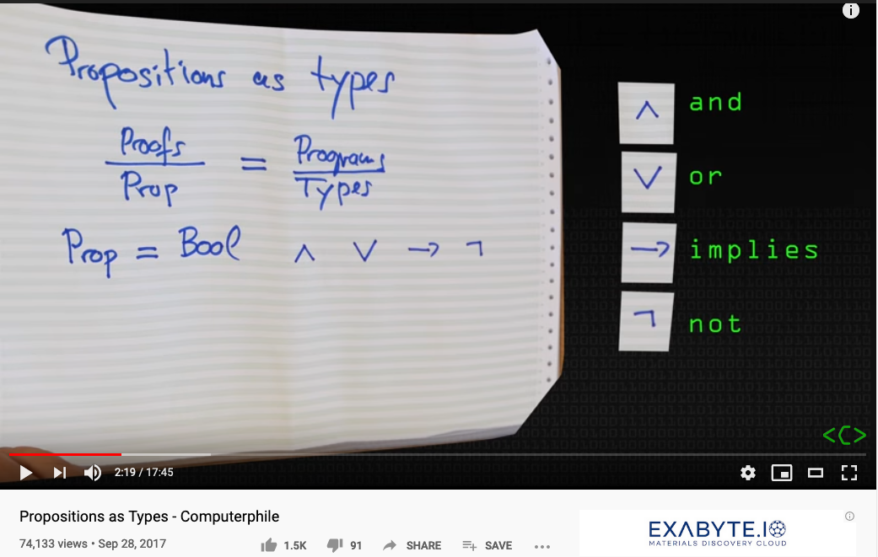
Propositions as Types (names with format)
Video Link: https://youtu.be/SknxggwRPzU?t=139
Video Link: https://youtu.be/aeRVdYN6fE8?t=2793

Slide 31
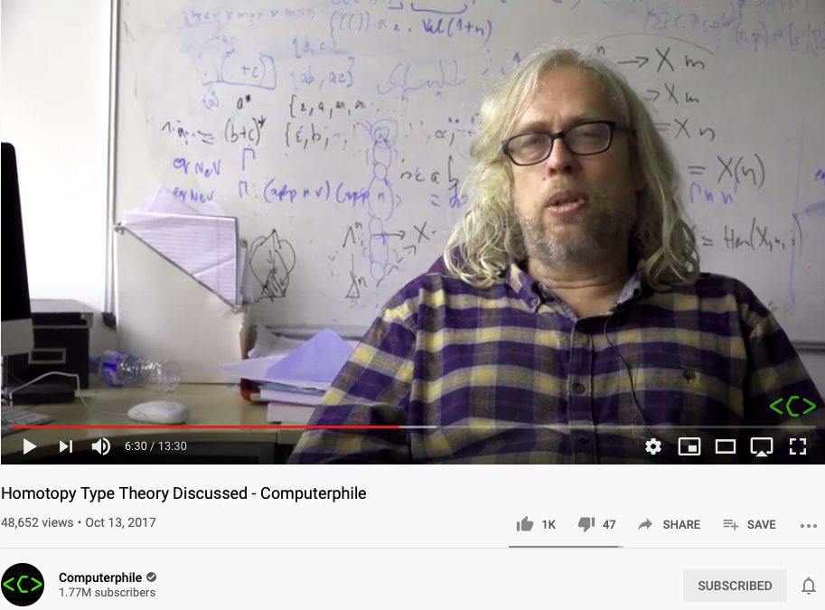
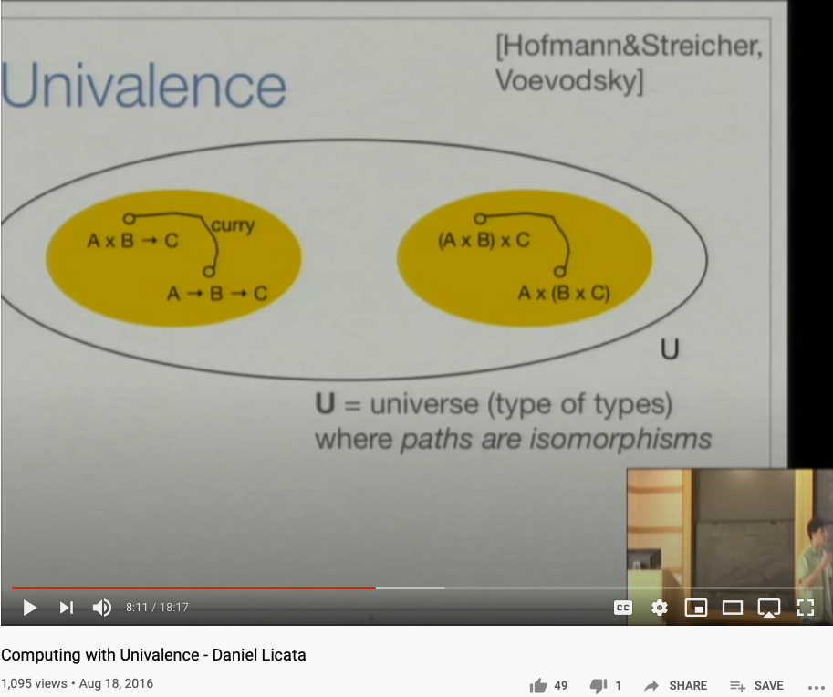
Representing Functions as Paths
Video Link: https://youtu.be/Ft8R3-kPDdk?t=390
Video Link: https://youtu.be/YDdDuq2AGw4

Slide 32
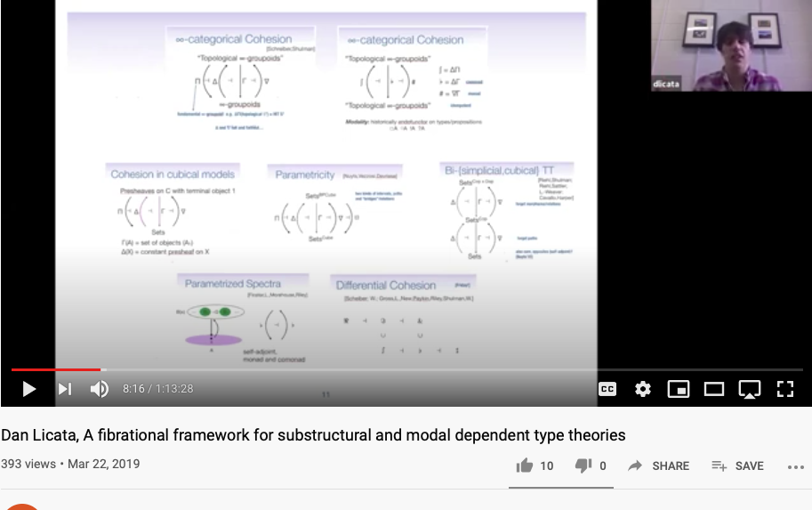
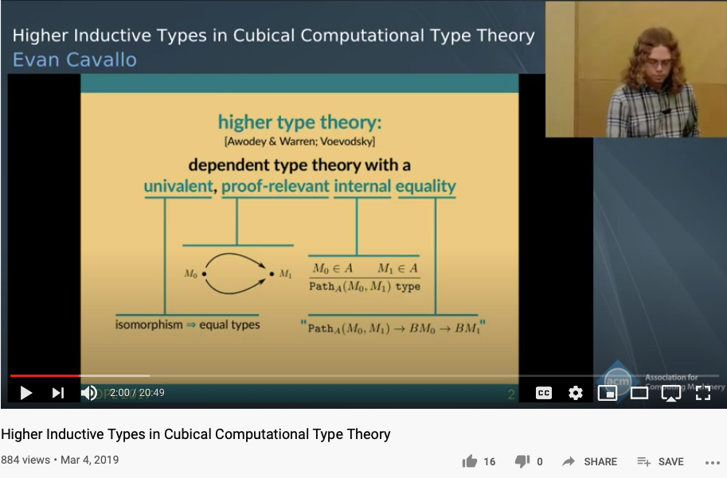
From Category Theory to Higher Type Theory
https://youtu.be/-DP0wY2FBs4?t=496
https://youtu.be/cmYzJAsjYSo

Slide 33
Soundness
Completeness
Every provable statement is true
Every true statement is provable
Cited from : Soundness and Completeness: With Precision on news.ycombinator.com

Slide 34
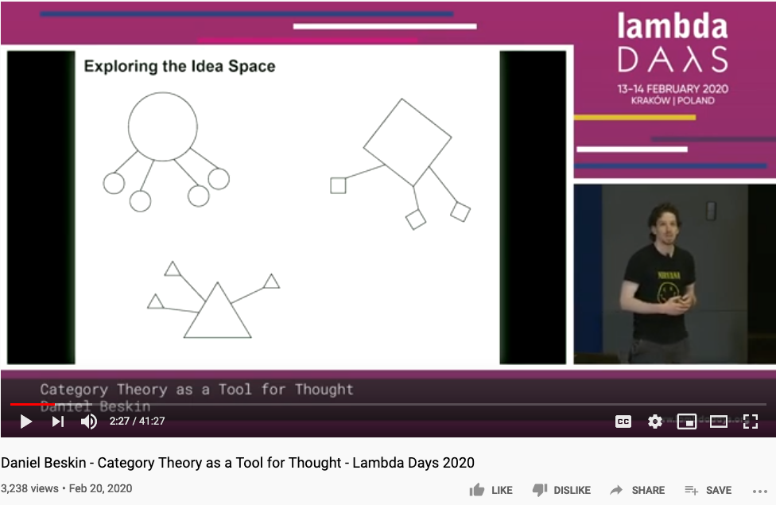
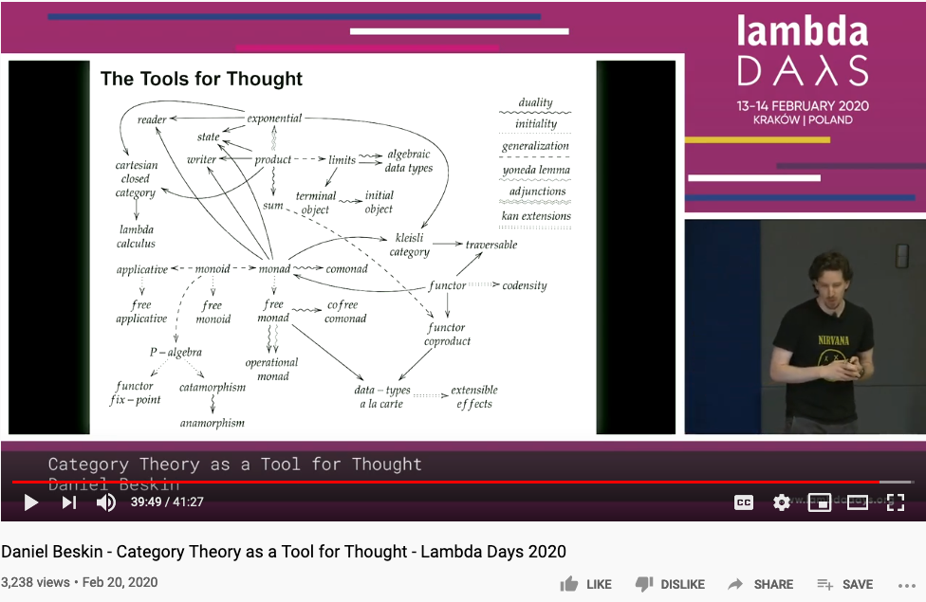
All concepts (ideas) are Kan Extensions -Saunder Mac Lane
https://github.com/ncreep/category-theory-as-a-tool-for-thought

Slide 35
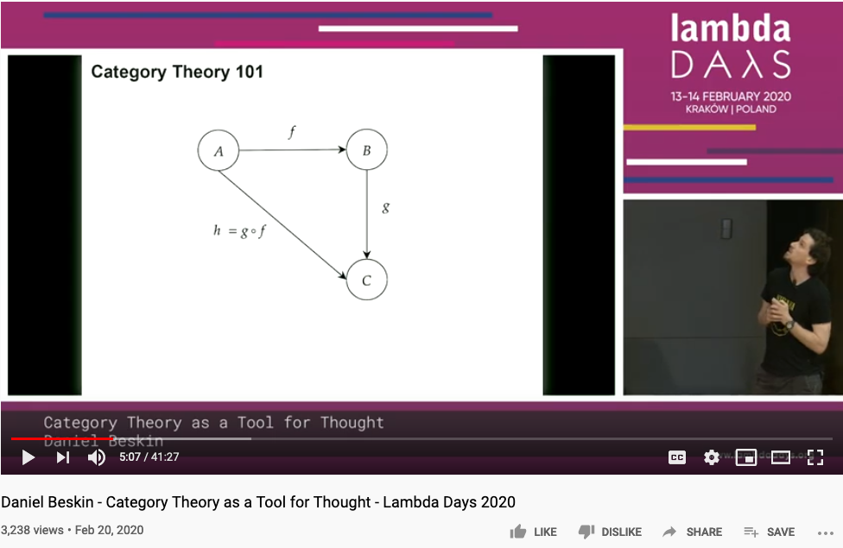
Category Theory is all about Composing Arrows

Slide 36
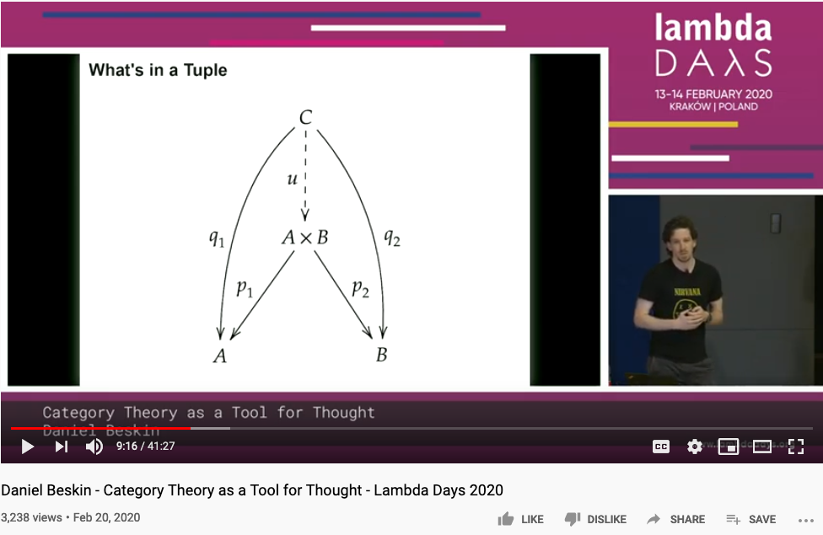
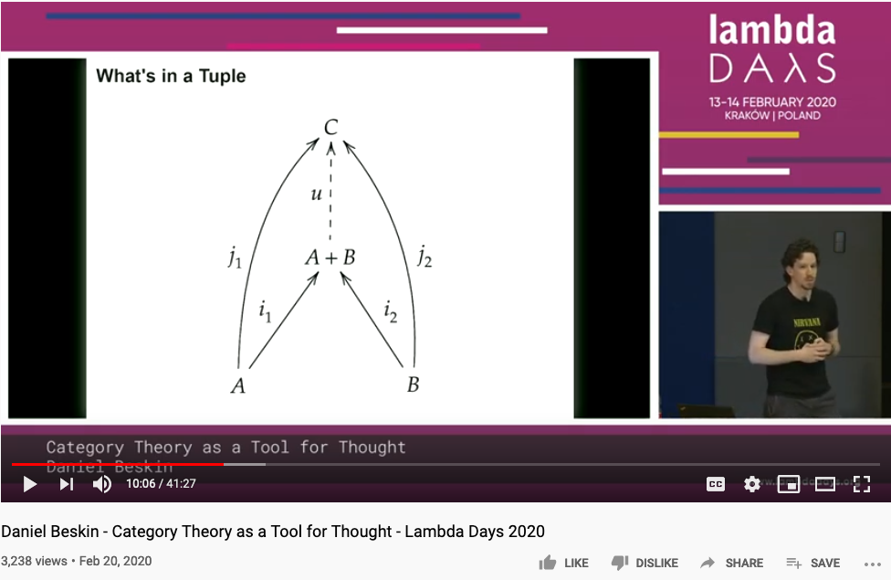
Universal Constructions

Slide 37
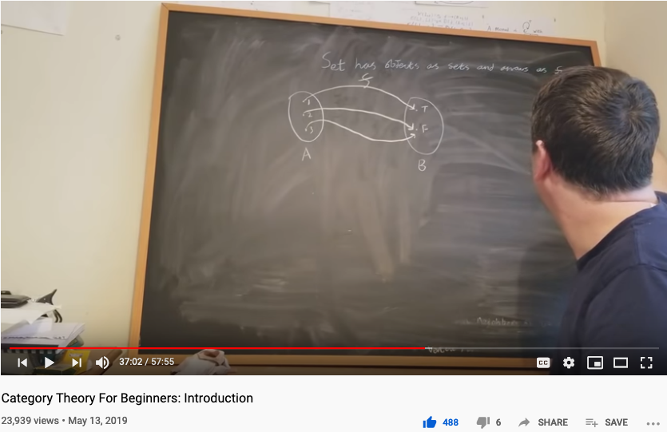
The Best One Hour Summary of Category Theory
Category Theory for Beginners (video series) -Richard Southwell

Slide 38
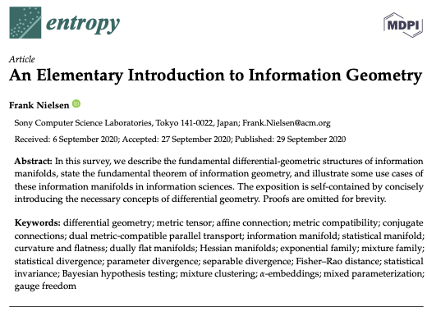

The Geometry of Information

Slide 39


Higher Dimensional Structure denoted by Arrows
https://youtu.be/lmcT2mP2bfE?t=183
https://youtu.be/lmcT2mP2bfE?t=481

Slide 40


The Idea of Multiplication expressed in Arrows
https://youtu.be/lmcT2mP2bfE?t=967
https://youtu.be/lmcT2mP2bfE?t=1021

Slide 41
The World According to Category Theory
Find an image that shows arrow that
points to another arrow
A mathematical foundation based on one notation: arrow!
Also known as the arrow chasing computation.

Slide 42



The Types of Arrows
If it looks like a pig, walks like a pig, and taste like a pig, it is a pig.

Slide 43

Verticle Composition
Page. 175 of Category Theory for Programmers

Slide 44

Horizontal Composition
Page. 176 of Category Theory for Programmers

Slide 45



Kleisli Arrow of outrageous Fortune

Slide 46
Category Theory and Unary Arithmetic
How to do computation with only one symbol?
Verbs and Nouns are the same type!
Operators and Operands are “Terms” (Names)

Slide 47

Category Theory and Type Theory

Slide 48



















Three Kinds of Arrows
安全素养来自可分析、可聚合的思维基础，三层次的认知和范畴论中的类比与函数具有对应关系
1.函数 (Function)
$$A \underset{→}{ f } B$$
$$A$$
Object / Set $A$
Category $S$
A function $f$ from set $A$ to set $B$
2.函子 (Functor)
$$S$$
$$\underset{→}{ F }$$
$$T$$
$$A \underset{→}{ f } B$$
$$C \underset{→}{ g } D$$
A functor $F$ from category $S$ to category $T$
$$S \underset{→}{ F } T$$
Functor $F$
$$F$$
3.自然转换 (Natural Transformation)
Natural transformation compares a parallel pair
$$S$$
$$T$$
$$F \underset{→}{ η } G$$
$$η$$
Natural Transformation $η$
$$G$$

Slide 49
The Idea of Universality
范畴论：
用箭头当作对所有信息编码的
唯一一类符号

Slide 50
Construct Story Telling using Metaphorical Connections
 | Story Telling | Metaphors | Categorical Arrows
Dynamics | Story Plot | Types of Outlines | Natural Transformation
Compositional Laws | Morals of the Story | Existing Stories | Functor/Structure Preservation
Building Blocks (BB) | Spacetime Context and the Characters | Names of the BB | Functions/Morphisms/Objects

Slide 51





Category Theory
Viable airspace
trajectories
Blockchain
Is the tool to represent and compute complex networks
Cognitive and Brain Science
A.I. decision Matrix
Start-Up viability
Predict formerly unpredictable
Solve the Mysteries of Life
Notes:
Predict formerly unpredictable

Slide 52




Trend
Based on
“category theory” interest over past 5 years (worldwide):
Legend:
Numbers represent search interest relative to the highest point on the chart for the given region and time.
A value of 100 is the peak popularity for the term.
A value of 50 means that the term is half as popular.
Likewise a score of 0 means the term was less than 1% as popular as the peak.
Related topics
Related queries
Legend
The most popular topics. Scoring is on a relative scale where a value of 100 is the most commonly searched topic, a value of 50 is a topic searched half as often, a value of 0 is a topic searched for less than 1% as often as the most popular topic.
Legend
The most popular topics. Scoring is on a relative scale where a value of 100 is the most commonly searched topic, a value of 50 is a topic searched half as often, a value of 0 is a topic searched for less than 1% as often as the most popular topic.
Notes:
Category theory has become an important role in contemporary mathematics and theoretical computer science.

Slide 53



Founders of Category Theory:
Saunders Mac Lane/Samuel Eilenburg
https://en.wikipedia.org/wiki/Saunders_Mac_Lane
https://en.wikipedia.org/wiki/Samuel_Eilenberg
Notes:
Category theory has become an important role in contemporary mathematics and theoretical computer science.

Slide 54

Mathematical Models:
A Sketch for the Philosophy of Math (1981)
The Lower part of the Table 1 of the paper
http://links.jstor.org/sici?sici=0002-9890%28198108%2F09%2988%3A7%3C462%3AMMASFT%3E2.0.CO%3B2-D
Notes:
Category theory has become an important role in contemporary mathematics and theoretical computer science.

Slide 55
Mathematical Models:
A Sketch for the Philosophy of Math (1981)
Mathematics begins with puzzles and problems dealing with combinatoric and symbolic aspects of the general human experience. Some of these aspects turn out to be systematic and intrinsic, rather than arbitrary and tied to one context. … These observations can be described as starting with a variety of human activities, each one of which leads more or less directly to a corresponding portion of mathematics:
Counting | Arithmetic, Number Theory
Measuring | Real Numbers, Calculus, Analysis
Shaping | Geometry, Topology
Forming | Symmetry, Group Theory
Estimating | Probability, Measure Theory
Moving | Mechanics, Calculus, Dynamics
Calculating | Algebra, Numerical Analysis
Proving | Logic
Puzzling | Combinatorics, Numer Theory
Grouping | Set Theory, Combinatorics
http://links.jstor.org/sici?sici=0002-9890%28198108%2F09%2988%3A7%3C462%3AMMASFT%3E2.0.CO%3B2-D
Notes:
Category theory has become an important role in contemporary mathematics and theoretical computer science.

Slide 56

范畴论就是： 复杂网络的数学
John Baez* : “Category Theory is the Mathematics of networks.”
https://www.youtube.com/watch?v=IyJP_7ucwWo
Based on Marquis, Jean-Pierre on Stanford Encyclopedia of Philosophy**: “Category theory has become an important role in contemporary mathematics and theoretical computer science. It is a powerful language, or conceptual framework, allowing us to see the universal components of a family of structures of a given kind, and how structures of different kinds are interrelated”
Source: *John Baez’s Stuff, http://math.ucr.edu/home/baez/
**Jean-Pierre Marquis, https://plato.stanford.edu/archives/win2015/entries/categorytheory/
Notes:
Category theory has become an important role in contemporary mathematics and theoretical computer science.

Slide 57
范畴论: 不需要数字的计算方法（基于箭头的算术）
A Category is a diagram composed of Objects and Arrows
构成
B
f
g
h
A
C
案例: 由三个对象 (A,B,C) 和两个箭头(f, g)所构成的范畴
“Category Theory is a graph with a rule for composing arrows (f,g) head to tail to give another arrow (h)。”
M. Barr, and C. Wells, Category theory for computing science. 1990. 21.

Slide 58
Formal Definition of Category Theory
所有的范畴必须满足以下条件：
id_{B}
B
f
g
A
C
id_{A}
id_{C}
由箭头与箭头所指的对象所构成
每一个对象X 必然有一个自指的箭头 id_{X}
首尾相连接的箭头可以“构成”（compose）新的箭头

Slide 59
Category Theory is about composing Arrows
下列两个箭头( f, g ) 可被构成/聚合 (composed ) 为一个箭头 h
B
f
g
A
h
C
范畴论的符号系统是用来展现函数/函子/自然转换的可聚合性（composability）

Slide 60

Universal Morphism
The most important definition in category theory: Universal Property

Slide 61
Compute by Arrow Chasing
B
B
Always implies:
f and g can be
composed into
h
where
h = g ◦ f
f
g
f
g
A
h
C
h = g ◦ f
A
C
Functional Composition
h = g ◦ f

Slide 62
Measurement results come from:
comparison/symmetry-breaking

Slide 63


Slide 64


Functor in Action
https://youtu.be/XcM39gnqgNc?t=155
https://youtu.be/YLIH8TKbAh4?t=389

Slide 65



Various ways to interpret Natural Transformation
Think about Natural Transformations as various kinds of Abstract Interpretations?

Slide 66

ALL Concepts can be represented using Kan Extension
A highly useful mathematical construct for teaching and learning abstractions.

Slide 67

Multiplication

Slide 68

Addition

Slide 69

Applied Category Theory
These mathematical ideas are strategies for Knowledge Representation

Slide 70



Functional Composition
Decomposition
C
C ^{OP}
3D printing
3D printing
g
F ^{op}
f
f ⁻¹
g ⁻¹
2D printing
1D movement
(Opposite Functor)
2D printing
1D movement

Slide 71









函数对等性与交换律(Commutativity)
两条首尾对象相同的路径表示:两套函数 (morphisms) 可对等交换 “commutes”
h = g ◦ f
$$\underset{→}{ f }$$
$$\underset{→}{ g }$$
The crucial aspect of a category is that
two appropriately compatible arrows can
be combined (by composition ) to form a third
arrow.
$$\underset{→}{ h }$$
$$\underset{→}{ f }$$
q ◦ k = g ◦ f
$$\underset{→}{ k }$$
$$\underset{→}{ g }$$
$$\underset{→}{ q }$$

Slide 72


Any ordered system，can be represented by Arrows

Slide 73
Workflow or product systems in Arrowed Structures
Initial Idea
Identify Customer Needs
Establishing technical specification
Initial Idea
Collecting competitive benchmarking
Identify Opportunities
List of Customer Needs
List of Opportunities
Reflect on the result and the process
Evaluate and Prioritize Project
Establish the relative importance
Reflect on the result and the process
Filtered Opportunities
Filtered Customer Needs
Allocate Pre-project Planning
Interpret raw data in terms of customer need
Project Idea
Customer Needs Raw Data
Gathering Raw Data
Re-evaluate Result and Process

Slide 74
(Following from Previous page)
Target Specification
Concept Generation
Establishing technical specification
Final Product Concept
List of Metric Specifications
Measuring & interpreting concept
Reflect the result and the process
Collecting competitive benchmarking
List of Survey Result
Surveying concept
Competitive Evaluation List
List of Concept Scoring
Set Ideal marginal value
Scoring
Re-evaluate screening
Re-evaluate Result and Process
Target Specification List
List of Concept Screening
Screening
List of Concept Generation
Determining concept generation

Slide 75

The Commonalities of these different characters?
Notes:
Nespresso borrowed the insights from Hp, basically “If selling replacements is succesful then we have to focus on the replacements to succeed”
Borrowing experiences across industries to overcome Industry Barriers and failing one and again with the same complex problems.

Slide 76







Product Design by “Analogy”
C
F (Functor)
g
h
Maps similar structures across categories
h·g
F (Functor)
D
Think different, yet the same!
Notes:
Nespresso borrowed the insights from Hp, basically “If selling replacements is succesful then we have to focus on the replacements to succeed”
Borrowing experiences across industries to overcome Industry Barriers and failing one and again with the same complex problems.

Slide 77






Would simple “analogy” always work?
Development Process
g
h
C’
F
h·g
F (Functor)
αG
C’’
Category Company C
F’ (Functor)
?
?
C’’’
Notes:
Nespresso borrowed the insights from Hp, basically “If selling replacements is succesful then we have to focus on the replacements to succeed”
Borrowing experiences across industries to overcome Industry Barriers and failing one and again with the same complex problems.

Slide 78




Juicero Case
What happened?
120M USD
Doug Evans
Notes:
Initial idea:
Innovative small press could change the juicing industry.
Identify Customer Needs:
Customers need juice or a press?
Customers need fast and clean juice making
Smart phone app to monitor their diet
Target Specification:
Thousands of pounds on 200 cm² surface press
Home appliance or Businesses?
Producing a juice in <90 s
Concept Generation:
Over engineered (24 pieces for the lock door system).
Cold pressured
QR scan to apply the exact pressure.
-----------------------------------------------------------------------------------------------

Slide 79





Juicero by borrowing “Analogies”
Company
Development Process
Promotion Channel
F
h
f
αG
Natural transformation
h
G
g
i
H
Notes:
Nespresso borrowed the insights from Hp, basically “If selling replacements is succesful then we have to focus on the replacements to succeed”
Borrowing experiences across industries to overcome Industry Barriers and failing one and again with the same complex problems.

Slide 80


Juicero as a Textbook Case Study
Notes:
Nespresso borrowed the insights from Hp, basically “If selling replacements is succesful then we have to focus on the replacements to succeed”
Borrowing experiences across industries to overcome Industry Barriers and failing one and again with the same complex problems.

Slide 81

Tell a Story the Silicon Valley Style
Notes:
Nespresso borrowed the insights from Hp, basically “If selling replacements is succesful then we have to focus on the replacements to succeed”
Borrowing experiences across industries to overcome Industry Barriers and failing one and again with the same complex problems.

Slide 82
Conflicts/Branches/Intersections that don’t exist in Higher Dimensions

Slide 83


Counter Arguments in Higher Dimensions (intersection will not occur in Higher Dimensions)
https://youtu.be/lmcT2mP2bfE?t=551
https://youtu.be/lmcT2mP2bfE?t=579

Slide 84


范畴论可简化复杂的计算过程
Represents ONLY SOME possible trajectories to the moon
NKS 2004, MIT A New Kind of Language for Complex Engineering Systems
Case Study: NASA’s Apollo Program Benjamin Koo
Edward F. Crawley

Slide 85
完全没有算数逻辑的学科，不便成为科学！

Slide 86
外部因素：描述会 渗透/穿透 “运营背景” 边界的关键因素
抽象规范
运营背景：包括宏观/中观/微观时空场域的常用“标签”
目标：以在特定场域中达到欲求效果的 一个项目/函数/箭头 统一标签的别名
效果检验：为了达成目标的输出效果与输入资源的检验条件
输出结果：
可被统一的时间标签与命名空间联系的数据结果
具体实现过程
项目或函数的实现过程/算法细节
每一个实现过程与算法也可以被统一的标签来命名
输入资源：
可被统一的时间标签与命名空间联系的数据结果

Slide 87
认知技能来自隐喻
本体隐喻：脑中的概念与实体世界的联系
已熟悉的词汇 （如桌椅、门窗、飞禽走兽。。。）
空间隐喻：各物品或概念单元的时空定位关系
物件中的上下左右、事件发生的前后（偏序关系）
社会地位、亲属联系的高低大小关系
系统隐喻：整套物品（事件）的结构类似性
机器人对应与木流牛马
计算机的作业系统对应与国家的宪章

Slide 88
不论群体或是个人的“认知”都可用隐喻来解释
认知科学 | 数学（范畴论） | 社会学
本体隐喻 | 集合中的元素、特定的数值（0、1、3、e、pi、), 代数符号 （x、y、z）、 | 已知概念（数字、机构、指标、货币、。。。）
空间隐喻 | 数值之间的对应关系，（函數 Function) | 历史关系、合作关系 （产业链上下游关系），竞争关系
系统隐喻 | 不同範疇（Category）之間的結構對應关系（函子，Functor） | 知识地图、战略地图、产业或知识体系的演进过程（过程本身当作一种新旧之间的联系）

Slide 89

本体比喻 (Ontological Metaphor)
https://www.youtube.com/watch?v=acHxwB88dxk&t=99s

Slide 90

空间比喻 (Orientation Metaphor)
Audio-visual metaphors of the financial crisis: meaning making and the flow of experience
http://www.scielo.br/scielo.php?script=sci_arttext&pid=S1984-63982015000200311

Slide 91

系统比喻 （System Metaphor)
http://www.eoht.info/page/Analogy

Slide 92


Category Theory was invented to compare “Analogies”
Let’s see the example :
Functor
Category
Natural Transformation
Source : Milewski, 2015

Slide 93
认知的分类：个体认知能力／群体认知能力
个体认知：脑中概念的三类隐喻机制
语汇、语法、语境
群体认知：群众共同产生的概念隐喻机制
热门词典
约定成俗的行为规范
可确保成效的法规执行机制或交易渠道

Slide 94



Kuhn’s Cycle
https://www.thwink.org/sustain/glossary/KuhnCycle.htm

Slide 95

Kuhn’s Cycle
https://www.thwink.org/sustain/glossary/KuhnCycle.htm

Slide 96

Productivity loss due to Process Bottleneck
https://youtu.be/p7-U1_E_j3w

Slide 97

New Productivity came from CI/CD
https://youtu.be/p7-U1_E_j3w

Slide 98

关键词：Incommensurability （不可通约）
http://plato.stanford.edu/entries/incommensurability/
产业创新导致行为“范式”的转移
Paradigm shift (范式转移）
传统产业的范式，不再适用于新的社会环境
http://foodtank.com/news/2015/01/five-ways-cell-phones-are-changing-agriculture-in-africa

Slide 99

理解效果跟比喻的恰当性
http://structural-communication.com/Articles/Anatomy-metaphor-stclair.html

Slide 100
本体论与命名空间管理

Slide 101

Symmetries and Arrows
Image source: https://youtu.be/pt0aorJvKVg?t=53

Slide 102
隐喻的分类：本体／空间／系统 Metaphors are Symmetries in Meaning
本体隐喻：脑中的概念与实体世界的联系
已熟悉的词汇 （如桌椅、门窗、飞禽走兽。。。）
空间隐喻：各物品或概念单元的时空定位关系
物件中的上下左右、事件发生的前后（偏序关系）
社会地位、亲属联系的高低大小关系
系统隐喻：整套物品（事件）的结构类似性
机器人对应与木流牛马
计算机的作业系统对应与国家的宪章

Slide 103


管理本体隐喻：管理MediaWiki词汇

Slide 104
Mathematical Models: A Sketch for the Philosophy of Math (1981)
Saunders Mac Lane从数学文献中所总结出的各种动词片语
Counting | Arithmetic, Number Theory
Measuring （度量） | Real Numbers, Calculus, Analysis
Shaping （分辨形体） | Geometry, Topology
Forming （成形） | Symmetry, Group Theory
Estimating （估测） | Probability, Measure Theory
Moving （移动） | Mechanics, Calculus, Dynamics
Calculating （计算） | Algebra, Numerical Analysis
Proving （证明） | Logic
Puzzling （解谜、加密） | Combinatorics, Number Theory
Grouping （聚类） | Set Theory, Combinatorics
http://links.jstor.org/sici?sici=0002-9890%28198108%2F09%2988%3A7%3C462%3AMMASFT%3E2.0.CO%3B2-D
Notes:
Category theory has become an important role in contemporary mathematics and theoretical computer science.

Slide 105
Carlo Rovelli的 Ontological Map of Space-Time
Covariant Loop Quantum Gravity: An Elementary Introduction of Quantum Gravity Theory and Spinfoam Theory
by Rovelli and Vidotto

Slide 106
Partially Ordered Set
The Hasse diagram of the set of all subsets of a three-element set {x, y, z}, ordered by inclusion. Distinct sets on the same horizontal level are incomparable with each other. Some other pairs, such as {x} and {y,z}, are also incomparable. (Image and Text Source: Wikipedia: POS )

Slide 107
知识图谱：Ontological Engineering
Ontology engineering … studies the methods and
methodologies for building ontologies:
… formal representations of a set of concepts
… Core ideas and objectives of ontology engineering
are also central in conceptual modeling.
https://en.wikipedia.org/wiki/Ontology_engineering

Slide 108


Air Table/Google Table
https://youtu.be/r0lsyTaAuJE?t=16
https://youtu.be/EPs6BhLav94?t=32

Slide 109


可计算图：Computable Diagrams

Slide 110
词汇的比较 （Saunders Mac Lane vs. Modelica）
Counting | Arithmetic, Number Theory
Measuring （度量） | Real Numbers, Calculus, Analysis
Shaping （分辨形体） | Geometry, Topology
Forming （成形） | Symmetry, Group Theory
Estimating （估测） | Probability, Measure Theory
Moving （移动） | Mechanics, Calculus, Dynamics
Calculating （计算） | Algebra, Numerical Analysis
Proving （证明） | Logic
Puzzling （解谜、加密） | Combinatorics, Number Theory
Grouping （聚类） | Set Theory, Combinatorics

Slide 111


可计算图形语意：Computable Semantics

Slide 112

Sensor Placement and Data Collection

Slide 113
How Category Theory Simplifies Product Development
For a start-up, there are two possible outcomes which define two maneuvers, one reversible:
Succeed after a process, advance
Failed after a process, repeat, roll back [opposite from advance]
Repeat
Identify customer needs and problems
Advance
Advance (R&D)
Repeat
Roll Back
Roll Back
Repeat
Target specification and proof of concept
Roll Back
Development techniques / framework
Advance

Slide 114
How Category Theory Simplifies System Development
Can be simplified as :
A
B
Domain
Codomain
Data Gathering
Data Specifications
Identity Functor
Identity Functor
Eevery connection is reversible
Codomain
Domain
Infinite possibilities!!!
Find the viable paths to succeed!
Notes:
Identity functor

Slide 115


Slide 116


Slide 117


数学化的概念 Conceptual Mathematics
Authors:
William Lawvere
Stephen Schanuel

Slide 118
The Best One Hour Summary of Category Theory
Category Theory for Beginners (video series)
-Richard Southwell

Slide 119

The Best Summary on Type Theory
By the Discoverer of Monad Prof. Philip Wadler

Slide 120

Dependent Type Theory

Slide 121
Summary
A comparison chart that extends Applied Category Theory’s table by David Spivak

Slide 122



References
Youtuber blargoner: An introduction to categories, functors, and universal properties, with applications to the lambda calculus and functional programming.

Slide 123



References

Slide 124
Your actions before Oct 19, 2020
Start using Templates and Categories on toyhouse.wiki:81
Create a page about your project, using standardized Templates and Category
Make sure all Wiki pages you created follow the same Namespace convention
Start using Github to download and share files with proper NsM
Couse Github @ https://github.com/benkoo/CognitiveFoundation2020
Start writing your learning report.
Every week should include Logic Model using the standard Template
500 words or more per week

Slide 125

References
An interesting website on Gödel Escher Bach
https://aseelghazal.weebly.com/
GEB book’s ToC
Preface to GEB's Twentieth-anniversary Edition P-1 Overview p. viii List of Illustrations p. xiv Words of Thanks p. xix Part I GEB Introduction: A Musico-Logical Offering p. 3 Three-Part Invention p. 29 Chapter I The MU-puzzle p. 33 Two-Part Invention p. 43 Chapter II Meaning and Form in Mathematics p. 46 Sonata for Unaccompanied Achilles p. 61 Chapter III Figure and Ground p. 64 Contracrostipunctus p. 75 Chapter IV Consistency, Completeness, and Geometry p. 82 Little Harmonic Labyrinth p. 103 Chapter V Recursive Structures and Processes (...read more)

